Slide 1


Dev10 Capstone project
Garrett Becker

Slide 2
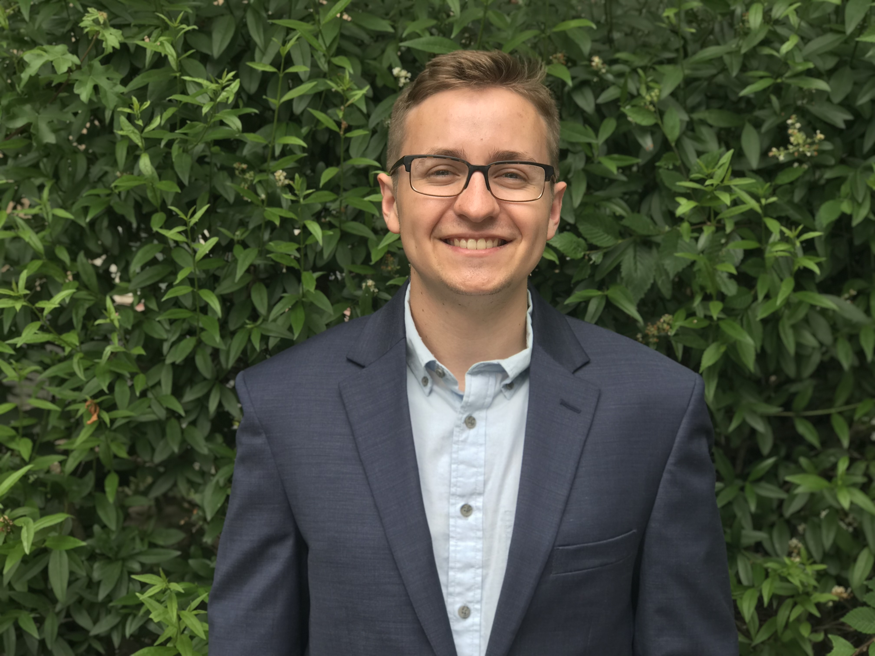
About Me
Background
Industrial Engineering degree from NC State University
Why software engineering & DEV10?
After reevaluating where my career direction was going with industrial engineering, I realized I needed a change. I thought about what I enjoyed the most about my time in the program at school and realized that coding came easily for me, and I liked the challenge and opportunity to hone in on a certain skill set. I found DEV10 while searching for intro programs and am excited about opportunities down the road

Slide 3
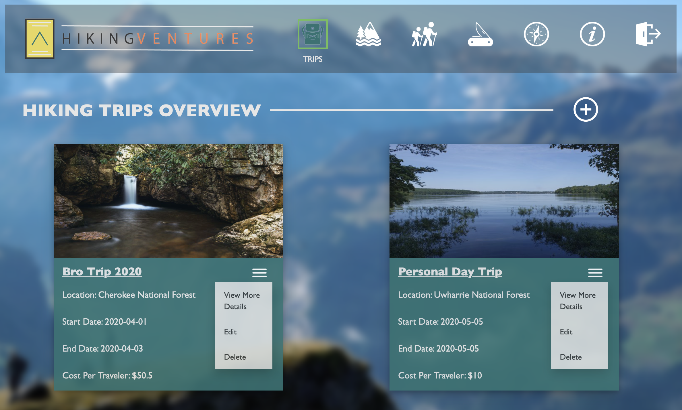
Project overview:
App Synopsis
Hiking Ventures is a robust, data-drive web application designed to make your life as simple as possible when it comes to planning your hiking trips.
Take the stress and hassle out of planning by using our sophisticated system and data.
Using Hiking Ventures will streamline your planning so that you can escape the everyday and go on the trip of your dreams.

Slide 4





Technology used
Core tools
MVC architecture
Bootstrap 4, HTML, CSS, & JavaScript
Spring & Spring Boot
MySQL relational databases
REST Service
JUnit Testing Suite
Tools for enhancements
JPA
Thymeleaf

Slide 5
DEMO

